Slide 1
Project Magma
Dominik Käser
Christian Oberholzer
Janick Bernet

Slide 2
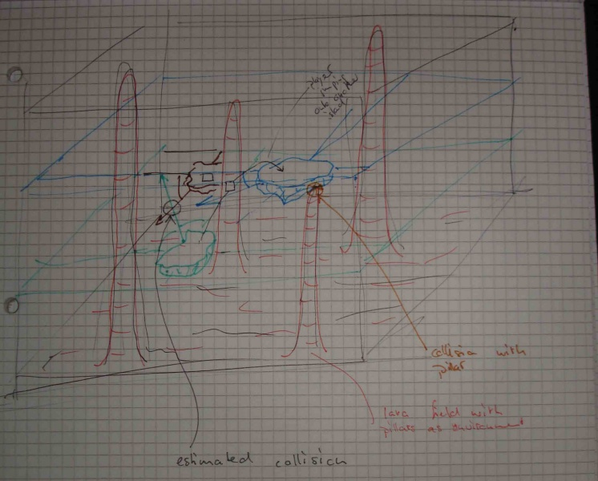
Game Description
Lava
Pillars
Hovering Islands
Players can move between islands
Players can fight each other

Slide 3
Game Strengths
Easily observable environment (one screen)
Various methods of interactions (direct combat, melee, islands moving)
Living environment (running lava)

Slide 4
Technical Items
Running lava
Colliding islands

Slide 5
Tools
XNA

Slide 6
Development Schedule
ID | Milestone | Description | Due Date
MS01 | Prototype Chapter Written | With this milestone the prototype chapter must have been written and added to the game notebook. Everyone in the team should also have installed and experimented with XNA in order to be ready for development. | March 16, 5pm
MS02 | Functional Minimum | With this milestone the functional minimum must be implemented, working and tested. | March 23, 12pm
MS03 | Interim Report Written | With this milestone the chapter with the interim report must have been written and added to the game notebook. | April 6, 5pm
MS04 | Low Target | With this milestone the low target shall be hit. | April 13, 12pm
MS05 | Desirable Target | With this milestone the team must have fulfilled the requirements for the desirable target. The prototype must be tested and in presentable order since it is needed for play testing in the week after. | May 4, 12pm
MS06 | Play test Chapter Written | With this milestone the play test chapter must have been written and added to the game notebook. This concludes that to this date all the play testing must be done. | May 11, 5pm
MS07 | Gold Version | With this milestone the development must have been concluded. All testing must have been finished and some of the high target functionality should be implemented. | May 25, 12pm
MS08 | Conclusion and Presentation | With this milestone the conclusion chapter must have been written and added to the game notebook. In addition the public presentation of the game must be ready to be held. | May 29, 5pm

Slide 7
Development Schedule
ID | Requirement | Assignee | Mo | Tue | Wed | Thu | Fri | Sat | Sun
ReqG01 | Basic Camera | cob |  | 2
ReqG03 | Basic Software Framework | cob | 8
ReqL01 | Lava Ground | jab |  | 3
ReqL02 | Basic Lava Effect | cob |  |  | 2
ReqL04 | Deadly Lava | jab |  | 3
ReqPi01 | Pillars | jab |  |  | 3
ReqPi02 | Basic Pillar Rendering | cob |  |  | 2
ReqI01 | Floating Islands | jab |  |  | 2
ReqI02 | Basic Island Rendering | dpk |  | 4
ReqP01 | Player | jab |  |  |  | 4
ReqP02 | Basic Player Model | dpk |  | 4 | 4 | 2
ReqP06 | Island Jumping | jab |  |  |  | 4
ReqP08 | Direct Combat 1 | jab |  |  |  |  | 4
None | Testing | jab/dpk/cob |  |  |  |  |  | 4 | 4
None | Work Estimates and Plan for MS05 | jab/dpk/cob |  |  |  |  |  | 1 | 1

